Slide 1
Project: Hero
Myat Min Maung
Yongcai Haung
Amrita Singh

Slide 2



Heros

Slide 3


Items

Slide 4


Shops

Slide 5


Skills

Slide 6
Tables Overview
> Character
> List Skill
> Skill
> Stat
> Catalog
> Inventory
> Shops

Slide 7
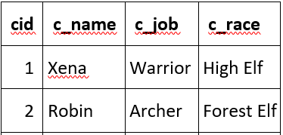
Tables (Characters)
> Character: 5 characters
CREATE TABLE `Character` (
`cid` INTEGER,
`c_name` TEXT,
`c_job` TEXT,
`c_race` TEXT,
PRIMARY KEY(`cid`)
);

Slide 8
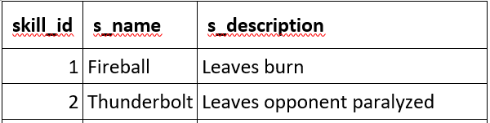
Tables
> List Skill: 5 skills
CREATE TABLE `List_Skill` (
`skill_id` INTEGER,
`s_name` TEXT,
`s_description` TEXT,
PRIMARY KEY(`skill_id`),
FOREIGN KEY(`skill_id`) REFERENCES `Skill`
);

Slide 9
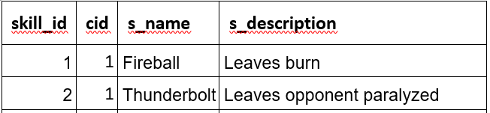
Tables
> Skills
CREATE TABLE `Skill` (
`skill_id` INTEGER,
`cid` INTEGER,
`s_name` TEXT,
`s_description` TEXT,
PRIMARY KEY(`skill_id`,`cid`),
FOREIGN KEY(`skill_id`) REFERENCES `List_Skill`,
FOREIGN KEY(`cid`) REFERENCES `Character`
);

Slide 10
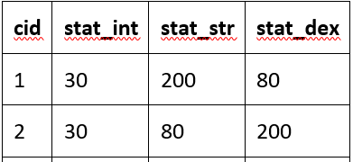
Tables
> Stat
CREATE TABLE `Stat` (
`cid` INTEGER,
`stat_int` INTEGER,
`stat_str` INTEGER,
`stat_dex` INTEGER,
PRIMARY KEY(`cid`),
FOREIGN KEY(`cid`) REFERENCES `Character`
);

Slide 11
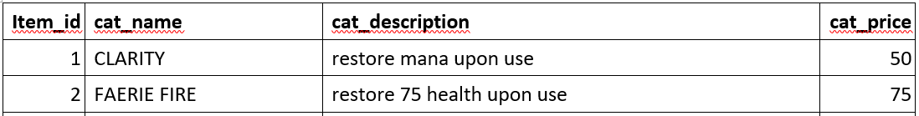
Tables (Items)
> Catalog
CREATE TABLE `Catalog` (
`item_id` INTEGER,
`cat_name` TEXT,
`cat_description` TEXT,
`cat_price` INTEGER,
PRIMARY KEY(`item_id`)
);

Slide 12
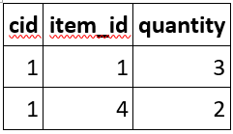
> Inventory
CREATE TABLE `Inventory` (
`cid` INTEGER,
`item_id` INTEGER,
`quantity` INTEGER,
PRIMARY KEY(`cid`,`item_id`),
FOREIGN KEY(`cid`) REFERENCES `Character`,
FOREIGN KEY(`item_id`) REFERENCES `Catalog`
);

Slide 13
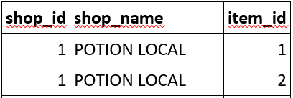
Tables
> Shops: 4 shops.
CREATE TABLE `Shop` (
`shop_id` INTEGER,
`shop_name` TEXT,
`item_id` INTEGER,
PRIMARY KEY(`shop_id`,`item_id`),
FOREIGN KEY(`item_id`) REFERENCES `Catalog`
);

Slide 14
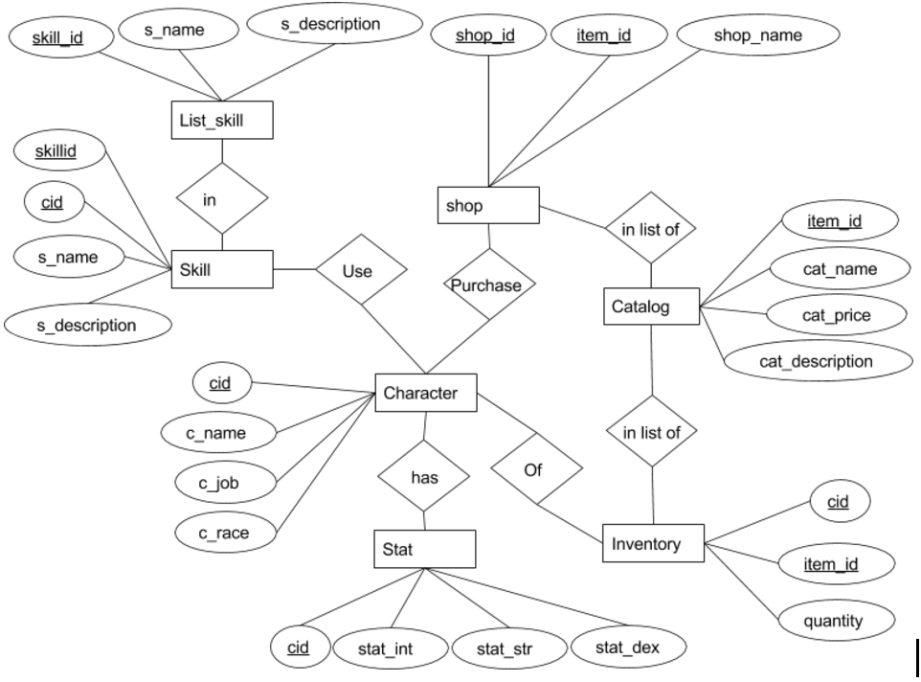
ER Diagram

Slide 15
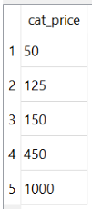
Examples
> Group By, Having and Aggregate Operator
SELECT C.cat_price
FROM Catalog C
Where C.cat_price >= 50
GROUP BY C.cat_price
HAVING COUNT (*) > 1;

Slide 16
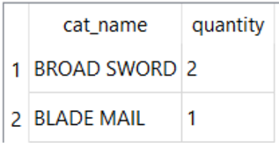
Examples
> Group By, Having and Aggregate Operator
SELECT C.cat_name , I.quantity
FROM Inventory I, Catalog C
WHERE C.item_id = I.item_id
GROUP BY I.item_id
HAVING COUNT(I.item_id) >= 3

Slide 17
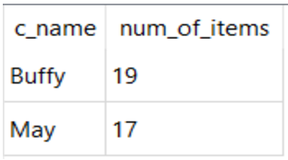
Examples
> Group By, Having and Aggregate Operator
SELECT C.c_name,SUM (I.quantity) AS num_of_items
FROM Inventory I, Character C
WHERE I.cid= C.cid
GROUP BY C.c_name
HAVING SUM (I.quantity)>15

Slide 18
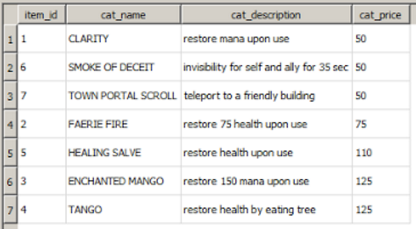
Examples
> Index
CREATE INDEX ItemByPrice ON Catalog (cat_price)
SELECT *
FROM Catalog INDEXED BY ItemByPrice
WHERE cat_price < 150;

Slide 19
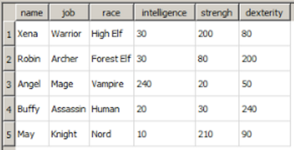
Examples
> View
CREATE VIEW CurrentPlayer(name, job, race, intelligence, strengh, dexterity )
as SELECT C.c_name, C.c_job, C.c_race, S.stat_int, S.stat_str, S.stat_dex
FROM Character C, Stat S
WHERE C.cid = S.cid
SELECT * FROM CurrentPlayer;

Slide 20
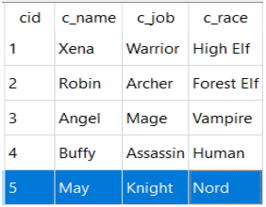
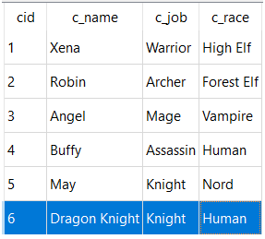
Examples
> Insert
INSERT INTO Character (c_name,c_job,c_race)
VALUES ('Dragon Knight','Knight','Human')
> Before > After

Slide 21
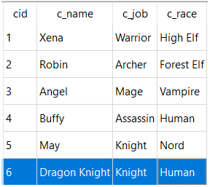
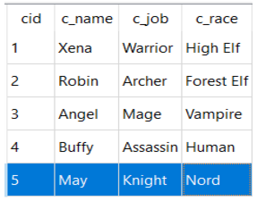
Examples
> Delete
DELETE FROM Character
WHERE c_name= 'Dragon Knight'
> Before > After

Slide 22
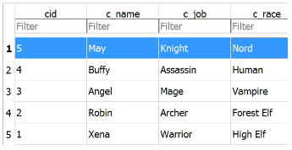
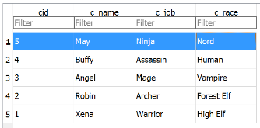
Examples
> Update
UPDATE Character
SET c_job = 'Ninja'
WHERE c_job = 'Knight'
> Before > After

Slide 23
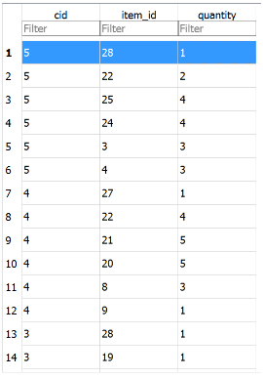
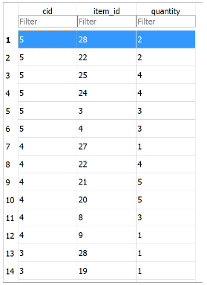
Examples
> Update > Before > After
UPDATE Inventory
SET quantity = 2
WHERE cid = 5 and item_id = 28
> cid 5: May
> item: Blade Mail

Slide 24
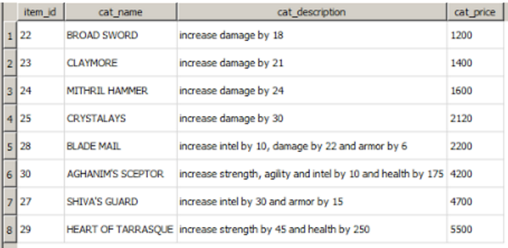
Examples
> Select
SELECT *
FROM Catalog INDEXED BY ItemByPrice
WHERE cat_price > 1000;

Slide 25
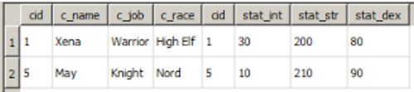
Examples
> Select
SELECT *
FROM Character C, Stat S
WHERE C.cid = S.cid AND S.stat_str >= 150;

Slide 26
Summary
What we did so far…
> 7 Tables
> ER Diagram
> 10 SQL Examples

Slide 27

Thank You

